Slide 1
Statically indeterminate problems in torsion

Slide 2
Statically indeterminate problems in torsion
To understand the idea better, we consider a single external torque only. The idea can easily be extended for multiple external torques.
L
A
C
B
l

Slide 3
Free body diagram
We proceed to draw the free body diagram
L
C
T
B
A
l
Free body diagram
T_{RA}
T_{RB}
T
A
C
B

Slide 4
Equations of torque equilibrium
We will get only one equation of torque equilibrium
T_{RA}
T_{RB}
T
A
B

Slide 5
Torque and twist as a function of x
A is our origin and our positive x direction is from A to B. Counterclockwise angles are positive.
x
T_{RA}
T_{RB}
T
A
C
B

Slide 6
Torque and twist as a function of x
Recall the formula for finding the angle of twist between points 1 and 2
For constant torque, uniform material property (constant G) and uniform cross radius (constant J)

Slide 7
Torque and twist as a function of x
In the domain AC
x
T_{RA}
T_{RB}
T
C
T(x)
B

Slide 8
Torque and twist as a function of x
In the domain CB
x
T_{RA}
T_{RB}
T
C
B
T(x)

Slide 9
Geometrical constraint
Net twist must be zero at B
L
C
T
B
A
l

Slide 10
Sample numerical problem
A circular bar fixed at both ends A and B is subjected to a torsional load of 100 Nm at quarter of its length from A. What are the reactions at the ends?
L
A
B
100 Nm
0.25L

Slide 11
L
A
B
100 Nm
Free body diagram
0.25L
T_{RA}
T_{RB}
A
B

Slide 12
Statics
Elastic constraint
Solving

Slide 13
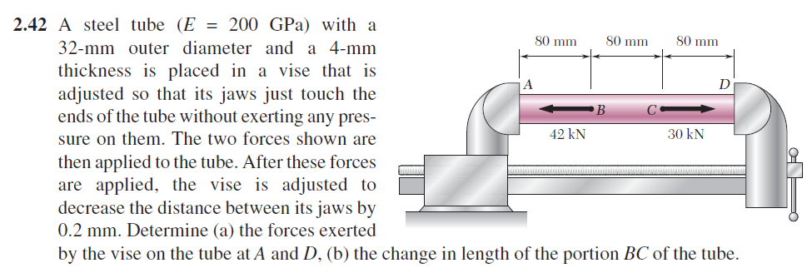

Slide 14
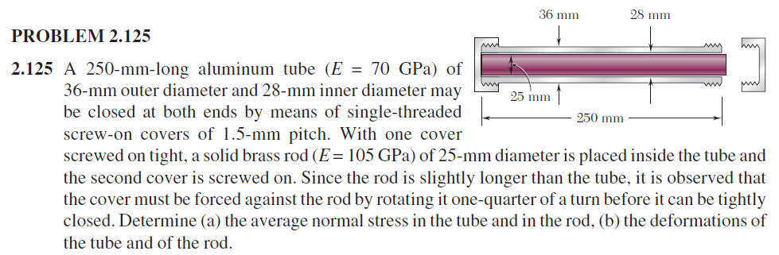

Slide 15
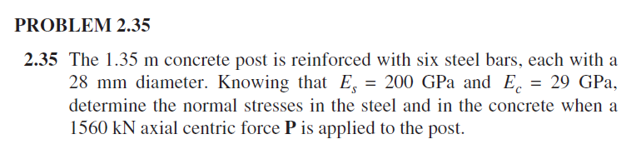
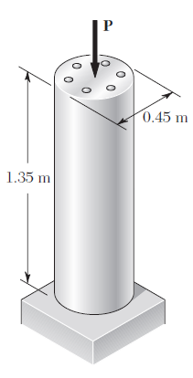

Slide 16
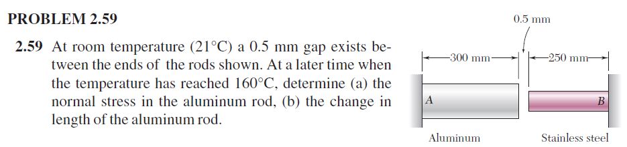

Slide 17
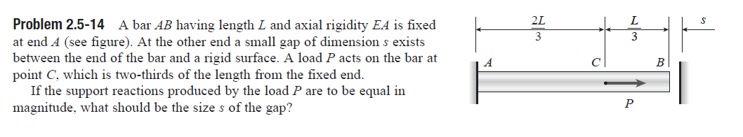

Slide 18
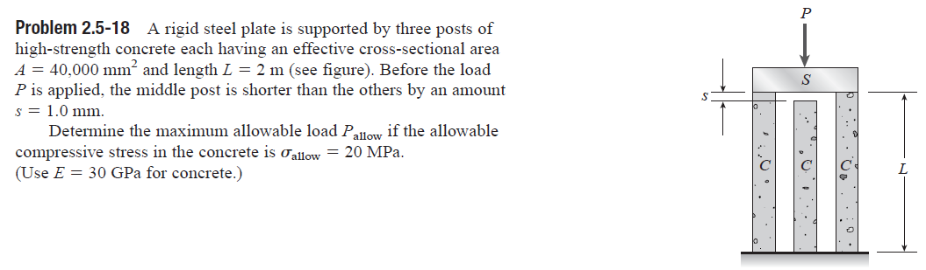

Slide 19
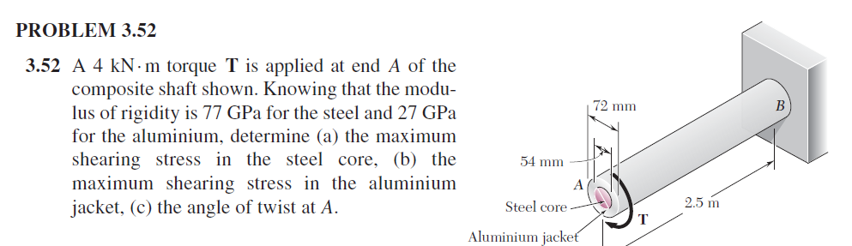

Slide 20
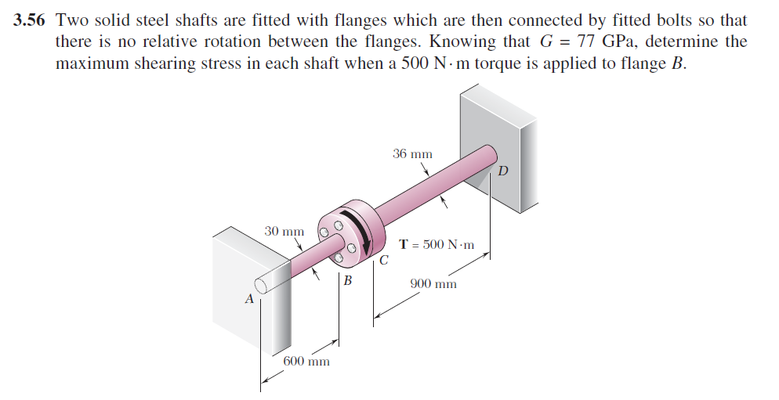

Slide 21
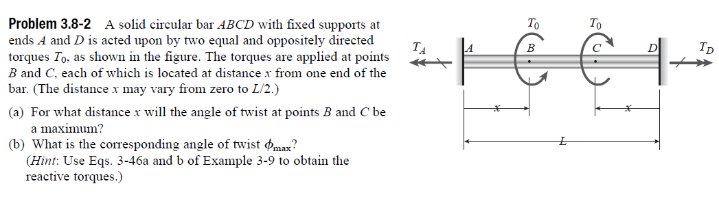

Slide 22
